Slide 1
Enhanced Athlete Tracking and Visualization
PIP104 University Project-II
Review-1
Batch Number:
Roll Number | Student Name
20211ISR0070 | Manoj C Acharya
Under the Supervision of,
Dr. / Mr. / Ms. Ruhin Kouser
Professor / Associate Professor / Assistant Professor
School of Computer Science & Engineering
Presidency University

Slide 2
Introduction
The integration of technology in sports has revolutionized the way athletic performance is monitored, analyzed, and visualized. This project focuses on developing a system that enables real-time tracking and performance visualization of runners on a track. By leveraging computer vision techniques, such as perspective transformation, the system maps 2D video footage into a 3D space, accurately overlaying crucial information within the runner's designated track region.
The system dynamically displays each runner's speed and distance to the finish line, providing an immersive and interactive way to monitor performance. Additionally, as runners cross the finish line, their names, departments, and rankings are prominently displayed on the track in real time. This feature ensures seamless updates to race results and enhances the overall viewing experience.
Designed to be both precise and responsive, the project demonstrates the potential of combining real-time data analysis and visualization for improving athletic performance and audience engagement. The technology holds promise for applications in sports analytics, event broadcasting, and athlete training programs.

Slide 3
Literature Review
Advancements in sports analytics have introduced innovative tools for monitoring athlete performance and enhancing training and competition strategies. The integration of computer vision and real-time data visualization has become a focal point in this domain, with numerous studies highlighting its applications.
1. Computer Vision in Sports Tracking
2. Perspective Transformation in Video Analysis
3. Real-Time Performance Metrics Visualization
4. Applications in Race Event Management
5. Gaps and Challenges

Slide 4
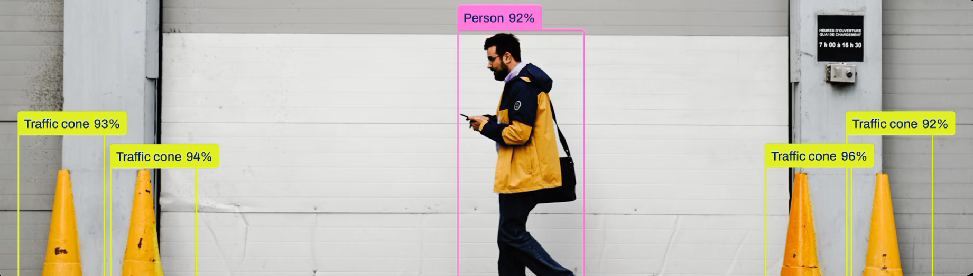
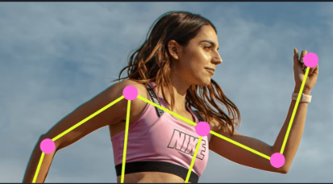
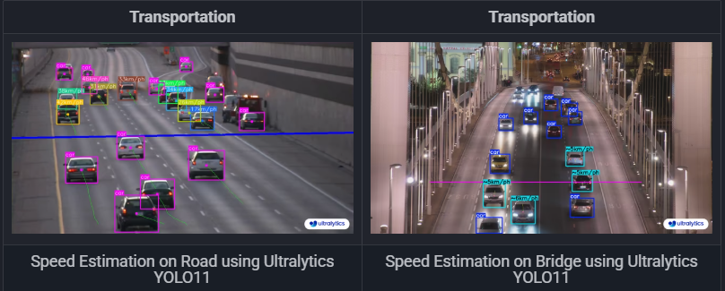
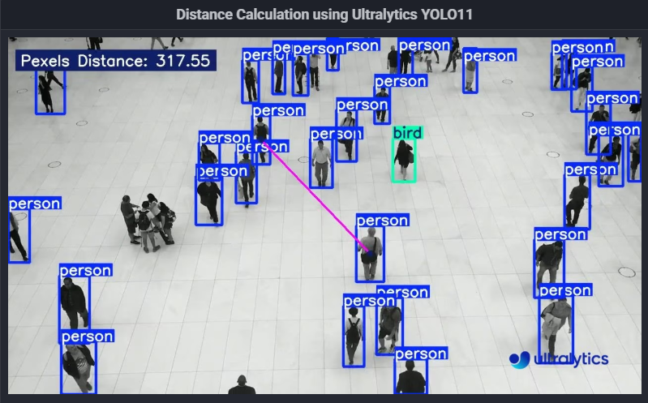
Proposed Method
The proposed methodology outlines a systematic approach to developing a real-time runner tracking and performance visualization system. By leveraging advanced computer vision techniques and the YOLOv11 object detection model, the system ensures precise detection and tracking of runners within a defined track region. Each runner is uniquely identified and monitored throughout the race, enabling accurate calculation of key metrics such as speed and distance to the finish line. The methodology integrates these components with a dynamic visualization system to display real-time performance data and final race results directly on the track, enhancing the usability and engagement of the solution.
1. Object Detection
2. Track Region Definition
3. Unique Identification of Runners
4. Lane Assignment
5. Speed and Distance Calculation
6. Real-Time Tagging and Visualization

Slide 5
Objectives
The objective of this project is to develop a real-time runner tracking and performance visualization system using advanced computer vision techniques. The system aims to accurately detect and track runners within predefined track regions, calculate their speed and distance to the finish line, and dynamically display this information on the track using perspective transformation. Additionally, the project seeks to provide an automated solution for determining race results by identifying the sequence in which runners cross the finish line, displaying their names and departments in real time, and updating rankings seamlessly. This technology is intended to enhance the efficiency, accuracy, and user experience in athletic event management and analysis.

Slide 6
Timeline of Project
Week | Dates | Tasks
Week 1 | November 1 - November 7 | - Finalize project scope and objectives. - Set up development environment (YOLOv11, Python, OpenCV). - Collect sample video data for testing.
Week 2 | November 8 - November 14 | - Implement YOLOv11 for human detection. - Apply filtering to detect only humans. - Test the detection model for accuracy and speed.
Week 3 | November 15 - November 21 | - Define track boundaries and Regions of Interest (ROI) for each lane. - Map runners to specific lanes. - Validate lane assignment with test data.
Week 4 | November 22 - November 28 | - Implement unique ID assignment for each runner. - Ensure consistent tracking of runners. - Test tracking in complex scenarios (occlusion).
Week 5 | November 29 - December 5 | - Implement speed calculation using positional data over time. - Develop distance calculation to the finish line. - Validate calculations with data.
Week 6 | December 6 - December 10 | - Implement real-time tagging and visualization. - Apply perspective transformation for proper integration of visual elements. - Test visualization.
Week 7 | December 11 - December 15 | - Develop finish line detection logic. - Implement real-time display of runner names, departments, and rankings. - Validate system with sample race.
Week 8 | December 16 - December 18 | - Conduct end-to-end system testing. - Optimize for performance (real-time responsiveness). - Fix bugs and refine UI.
Week 9 | December 19 - December 20 | - Prepare final project report and presentation. - Demonstrate the system and results. - Submit deliverables and conclude the project.

Slide 7
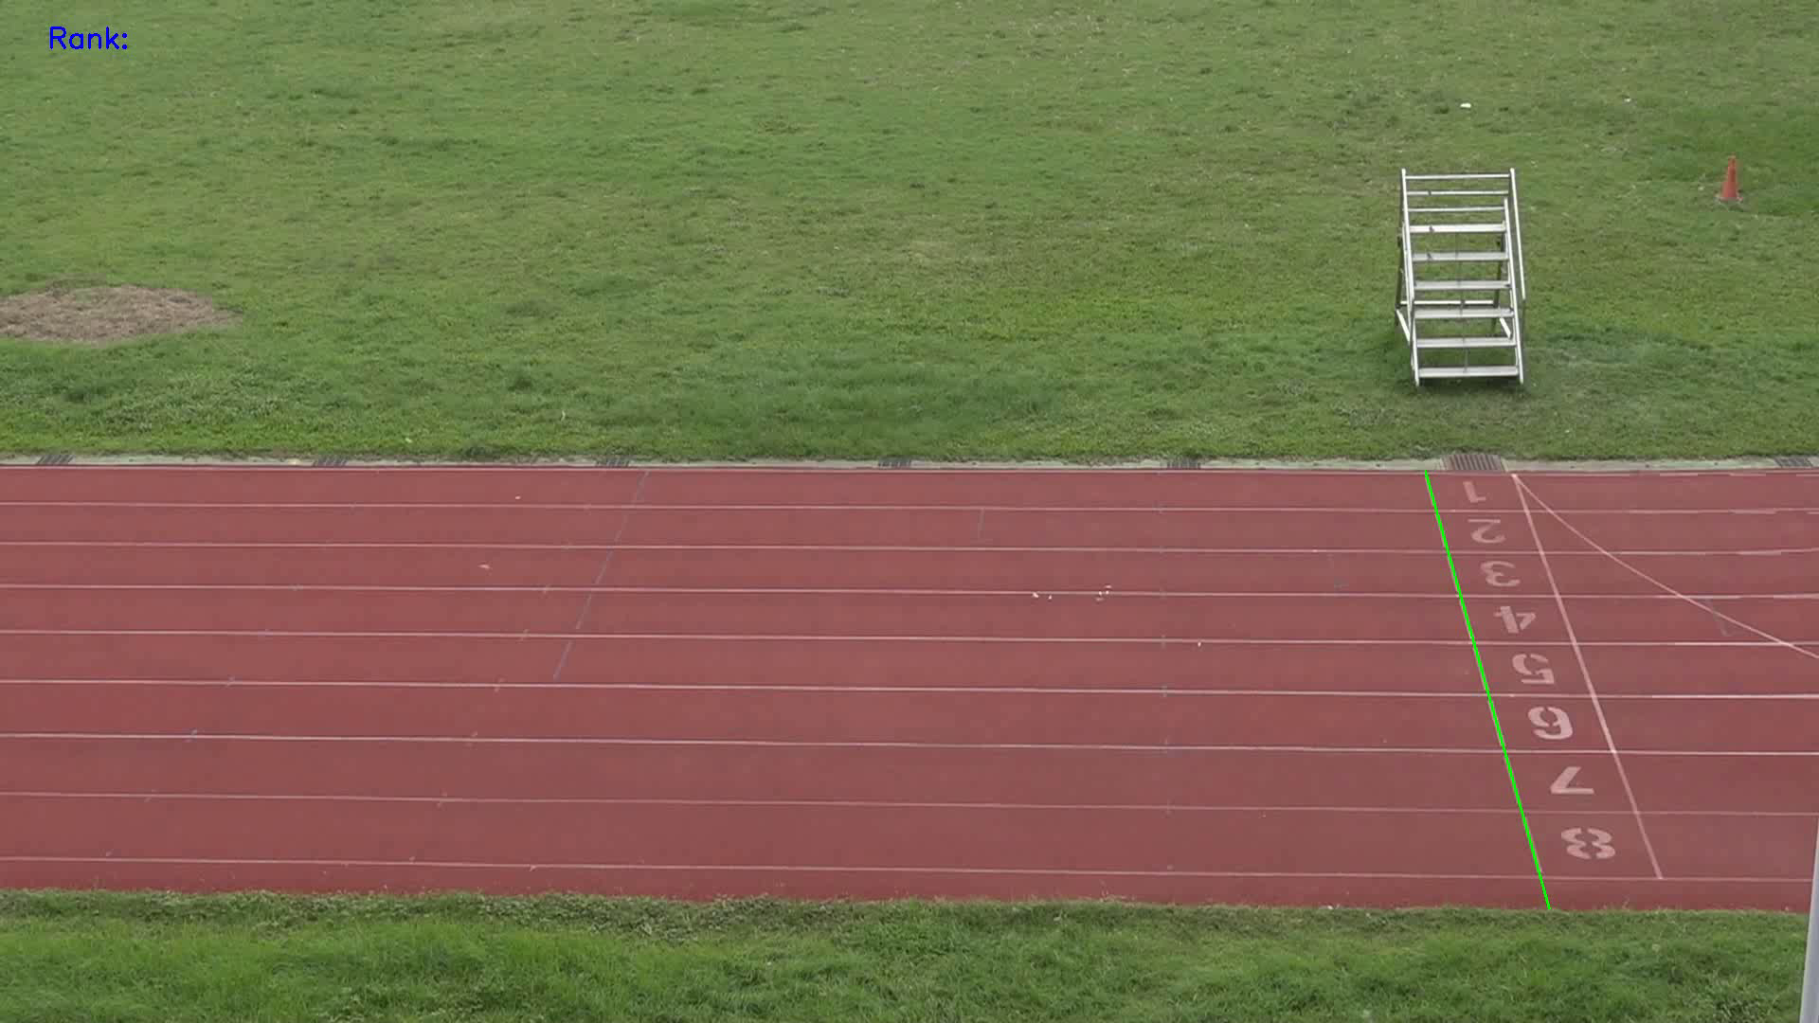
Expected Outcomes
1. Accurate Real-Time Runner Detection
2. Unique Identification and Consistent Tracking
3. Lane Assignment and Accurate Mapping
4. Real-Time Performance Visualization
5. Speed and Distance Calculation
6. Efficient Finish Line Detection and Result Display
7. Seamless User Interface
8. System Scalability and Robustness
9. Improved Event Management and Audience Engagement

Slide 8
Conclusion
This project presents a real-time runner tracking and performance visualization system designed to enhance the monitoring and analysis of athletic events. By integrating advanced object detection techniques, such as YOLOv11, and applying perspective transformation, the system effectively tracks runners within a defined track region and provides real-time performance data, including speed and distance. The use of unique IDs for each runner ensures accurate and consistent tracking, while dynamic visualization keeps both athletes and spectators informed.
The system's ability to calculate and display critical metrics in real-time, along with its automated race result updates, offers significant improvements to event management and audience engagement. The technology provides a scalable and robust solution, addressing challenges like crowd density and environmental factors.
In conclusion, this project showcases the potential of combining computer vision, real-time data processing, and dynamic visualization to revolutionize the way athletic events are managed and experienced, paving the way for further advancements in sports analytics and event broadcasting.

Slide 9
References
Redmon, J., Divvala, S., Girshick, R., & Farhadi, A. (2016). You Only Look Once: Unified, Real-Time Object Detection. *Proceedings of the IEEE Conference on Computer Vision and Pattern Recognition (CVPR)*, 779-788.
Zivkovic, Z., & van der Heijden, F. (2006). Efficient adaptive density estimation per image pixel for the task of background subtraction. *Pattern Recognition Letters*, 27(7), 773-780.
Wang, W., Li, S., & Zha, H. (2018). Real-time 3D tracking of sports players: A 3D reconstruction-based method. *IEEE Transactions on Image Processing*, 27(8), 4112-4126.
Shukla, S., & Bhardwaj, A. (2020). Automated race tracking using object detection and real-time data visualization. *International Journal of Sports Engineering and Technology*, 12(4), 189-198.
OpenCV. (n.d.). Open Source Computer Vision Library. Retrieved from https://opencv.org/
Ultralytics. (2021). YOLOv11: A state-of-the-art object detection model. Retrieved from https://github.com/ultralytics/yolov11
Matusik, W., & Pfister, H. (2004). 3D tracking and event detection for sports applications. *IEEE Transactions on Visualization and Computer Graphics*, 10(1), 34-45.
Chang, J., & Lin, M. (2017). Real-time visual tracking and speed estimation in athletic sports. *Journal of Real-Time Image Processing*, 16(3), 431-445.
Zhang, X., & Wu, Y. (2015). Real-time human tracking using multiple cameras and 3D transformation. *Journal of Computer Vision and Image Understanding*, 129, 1-12.

Slide 10
Thank You

